Slide 1
Welcome
Green Valley Sanitary District
Public Meeting
February 27th, 2024

Slide 2
Blaine Eilts Wastewater Specialist

Slide 3
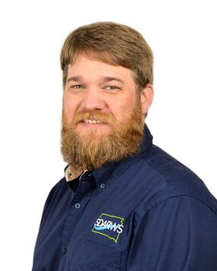
Kevin Christenson Source Water Protection Specialist

Slide 4
South Dakota Association of Rural Water Systems
Non-Profit Organization
Funding comes from USDA, EPA and membership dues
We help water and wastewater systems statewide
We provide equipment, services, training and technical assistance to communities that may not have the resources available

Slide 5
USDA Decentralized Wastewater Program
1. Identify and evaluate solutions to community water and wastewater problems, emphasizing communities and systems.
2. Assist with improving wastewater system management, operation, maintenance, and sustainability.
3. Increase the number of communities with improved environmental and public health outcomes.
4. Increase the number of communities with knowledge of and access to water and waste disposal loans and grants.
5. Promote rural residents’ equitable access to Rural Development programs and benefit from RD-funded projects.
6. Distribute materials to a broader audience and increase the value of existing programs, resources, and partnerships.

Slide 6
Rapid Creek Monitoring Data
Rapid City
Publicly available data from the South Dakota Department of Agriculture and Natural Resources (DANR)
Data shown is from the past five years
Upstream monitoring point: Where Rapid Creek meets E. Saint Patrick St. in Rapid City
Downstream monitoring point: Where Rapid Creek meets Anderson Road in Green Valley
Green Valley

Slide 7
Nitrogen
Fertilizer and sewage runoff is the biggest cause of nitrogen levels
Excessive nitrogen can overfeed aquatic plants causing decreased levels of dissolved oxygen resulting in a fish kill

Slide 8
Nitrogen
Rapid City
Green Valley

Slide 9
Phosphorus
Too much phosphorus can cause increased growth of algae and large aquatic plants, which can result in decreased levels of dissolved oxygen– a process called eutrophication
High levels of phosphorus can also lead to algae blooms that produce algal toxins which can be harmful to human and animal health

Slide 10
Phosphorus
Rapid City
Green Valley

Slide 11
Total Suspended Solids (TSS)
Total suspended solids (TSS) is the dry-weight of suspended particles that are not dissolved.

Slide 12
Total Suspended Solids
Rapid City
Green Valley

Slide 13
E. coli
When E. coli is found in surface waters, it means that there has been fecal contamination
While E. coli itself may be harmful to human health, other disease-causing organisms may also be present

Slide 14
E. coli
Rapid City
Green Valley

Slide 15
Conclusions
Surface water is being polluted from failing septic systems
Green Valley is polluting the creek more than the entire city of Rapid City
Price of projects usually increase with time and inflation
The EPA will have more restrictions as time progresses

