Slide 1

GREEN VALLEY SANITARY DISTRICT
PROPOSED SANITARY SEWER COLLECTION SYSTEM

Slide 2
OVERVIEW
Discussion of the Problem
Development of Alternatives
Project Alternative Costs
Funding Sources
User Costs of Selected Alternative
USDA RD Loan Grant Scenarios

Slide 3
DISCUSSION OF the PROBLEM
FEMA Floodplain
High Groundwater
Water Quality
Percolation Rates
(Mound System)
Notes:
Majority of the area is in floodplain: causes issues if flooded
High groundwater effects traditional septics and deep installations
2004 Mines report of water quantity siting failed septic systems
Poor perc rates resulting in mound systems $25k-$35k

Slide 4
DEVELOPMENT OF ALTERNATIVES
Conventional Gravity Sanitary Sewer Collection System
  8-inch Sewer Main with 4” Sewer Services
  Open Trench Installation
  Abandon Existing Septic Systems
  Mandatory Resident Hook-up
  Lift Station
  4 City of Rapid City Connection Points
  Rapid Valley Sanitary District Operate and Maintain (including billing)
  Treatment provided by the City of Rapid City
Notes:
Over 10 miles of sewer with 284 hookups

Slide 5
CONVENTIONAL GRAVITY SANITARY SEWER COLLECTION SYSTEM COST EASTIMATE
Opinion of Probable Construction Cost
  $20,375,200
Soft Costs (Engineering, Legal, Interim Financing, Land Acquisition)
  $4,232,200
City of Rapid City Connection Fee
  $253,369
Operations & Maintenance
  $151,320
TOTAL OPINION OF PROJECT COST
  $25,012,089
Notes:
20’ deep sewer mains
Deep lift station

Slide 6
DEVELOPMENT OF ALTERNATIVES
Small Diameter Sanitary Sewer Pressure System
  2-inch, 3-inch, 4-inch, & 6-inch Main with 1-1/4” Sewer Services
  Directional Bore Installation
  Abandon Existing Septic Systems
  Mandatory Resident Hook-up
  Individual Pumping Units (Maintained by the Homeowner)
  1 Rapid Valley Sanitary District Connection Point (No City of Rapid City Direct Connections)
  Rapid Valley Sanitary District Operate and Maintain (including billing)
  Treatment provided by the City of Rapid City
Notes:
Great of high ground water
Much smaller lines
Over 10 miles of sewer with 284 hookups

Slide 7
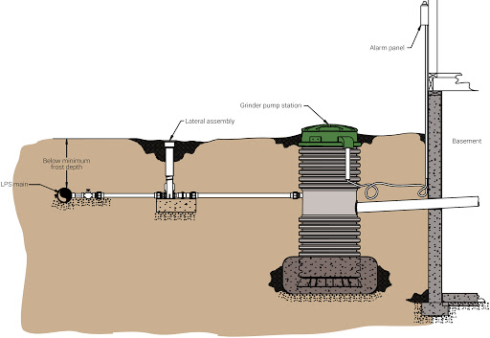
TYPICAL PRESURIZED SANITARY SEWER SYSTEM
(Steinbrecher Compnaies, Inc.)

Slide 8
SMALL DIAMETER SANITARY SEWER PRESSURE SYSTEM COST EASTIMATE
Opinion of Probable Construction Cost
  $7,436,900
Soft Costs (Engineering, Legal, Interim Financing, Land Acquisition)
  $2,808,900
City of Rapid City Connection Fee
  $0
Operations & Maintenance
  $50,000
TOTAL OPINION OF PROJECT COST
  $10,295,800

Slide 9
FUNDING SOURCES
South Dakota Department of Agriculture and Natural Resources
  Previous Award: $2,370,000
West Dakota Water Development District
  Award: $125,000
USDA Rural Development
  Pending Award

Slide 10
USER COSTS OF SELECTED ALTERNATIVE
Estimated Sanitary Sewer Bill
  Estimated Monthly Sanitary Sewer Usage per Home: 5,625 gallons per month
  Minimum Charge: $24.03
  Per 1,000 Gallon Charge: $5.88
  5.625 per 1,000 gallons * $5.88 = $33.08
  Administration Fee: $8.50
  Estimated Monthly Sewer Bill: $65.60
Pump Power Consumption Cost
  5.82 kwhr per month * $0.08827 per kwhr = $0.51
Notes:
Different depending on usage but this gives a general idea on how to calculate depending on water usage

Slide 11
USER COSTS OF SELECTED ALTERNATIVE
Estimated Special Assessment
  Total Opinion of Project Costs: $10,295,800
  SD DANR / WDWDD: -$2,495,000
  Total Opinion Of Project Costs Less Grant Funds: $7,800,800
  Accumulated USDA RD Loan Interest over 40 years @ 3%: $5,603,500
  Total Opinion of Project Costs to be Assessed: $13,404,300
  Total Annual Assessment: $335,108
  Total Monthly Assessment: $27,926
  Monthly Assessment per Household (284 Homes): $98
  1 Year Annual Assessment Accumulated over 10 Years: $10
Notes:
3% is current rate. Pay off date lessens as homes come on

Slide 12
USER COSTS OF SELECTED ALTERNATIVE
Total Estimated User Costs
  Sanitary Monthly Sewer Bill: $ 65.60
  Pump Power Consumption Cost: $ 0.51
  Monthly Assessment per Household + 1 Year Assessment (284 Homes): $ 108.00
  $174.11

Slide 13
USDA RD LOAN / GRANT SCENARIOS
60% Loan / 40% Grant
  Monthly Assessment per Household (284 Homes): $65.00 User Cost: $131.11
70% Loan / 30% Grant
  Monthly Assessment per Household (284 Homes): $76.00 User Cost: $142.11
80% Loan / 20% Grant
  Monthly Assessment per Household (284 Homes): $87.00 User Cost: $153.11
90% Loan / 10% Grant
  Monthly Assessment per Household (284 Homes): $97.00 User Cost: $163.11
Notes:
If not deemed affordable, no grants or funding would be awarded.

